Slide 1
BLM2041 Signals and Systems
Syllabus
The Instructors:
Doç. Dr. Ali Can Karaca
ackaraca@yildiz.edu.tr
Dr. Ahmet Elbir
aelbir@yildiz.edu.tr

Slide 2
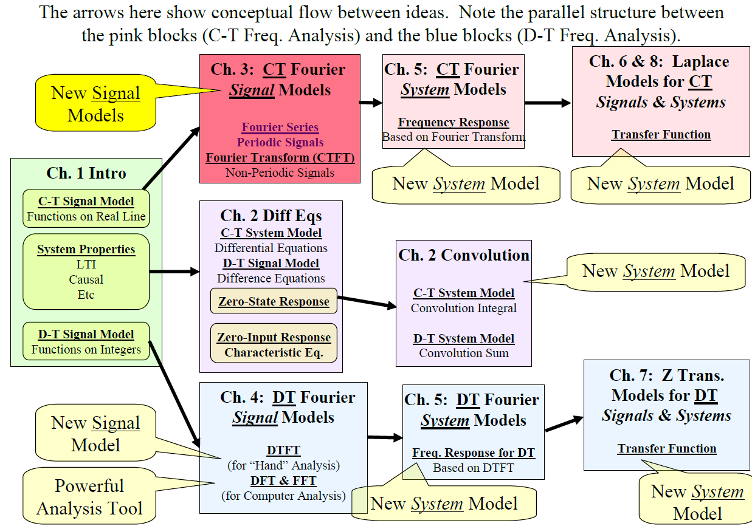
Where are we now?

Slide 3
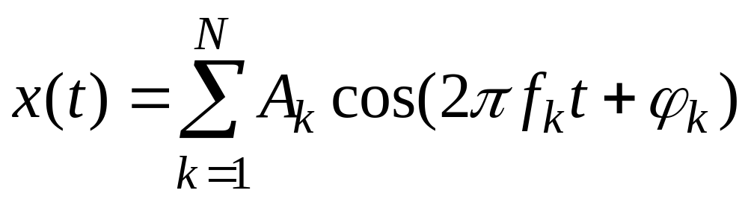
LECTURE OBJECTIVES
Sinusoids with DIFFERENT Frequencies
  SYNTHESIZE by Adding Sinusoids
SPECTRUM Representation
  Graphical Form shows DIFFERENT Freqs

Slide 4
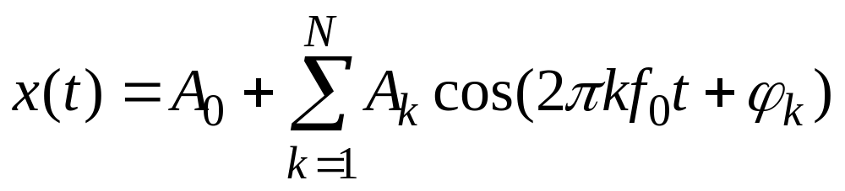
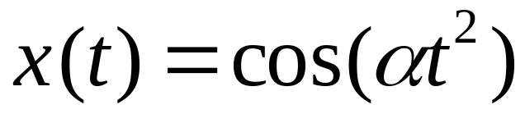
LECTURE OBJECTIVES
Signals with HARMONIC Frequencies
  Add Sinusoids with f_{k} = kf₀
FREQUENCY can change vs. TIME
  Chirps:
  Introduce Spectrogram Visualization (specgram.m) (plotspec.m)

Slide 5
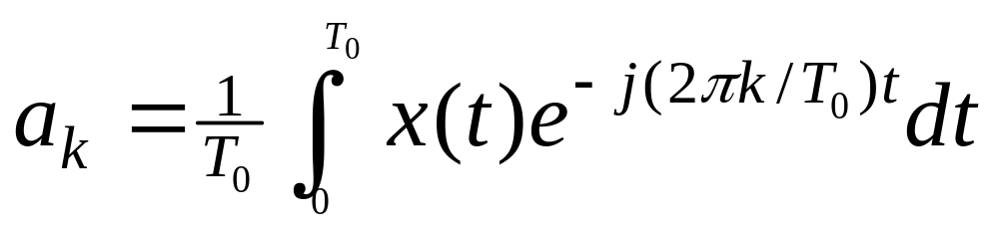
LECTURE OBJECTIVES
Work with the Fourier Series Integral
ANALYSIS via Fourier Series
  For PERIODIC signals: x(t+T₀) = x(t)
SPECTRUM from Fourier Series
  a_{k} is Complex Amplitude for k-th Harmonic

Slide 6

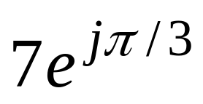
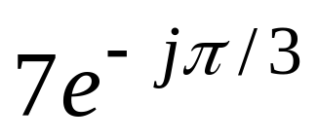
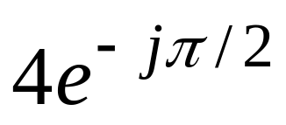
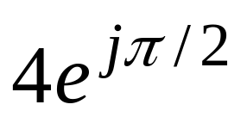
FREQUENCY DIAGRAM
Plot Complex Amplitude vs. Freq
–250
–100
0
100
250
f (in Hz)

Slide 7
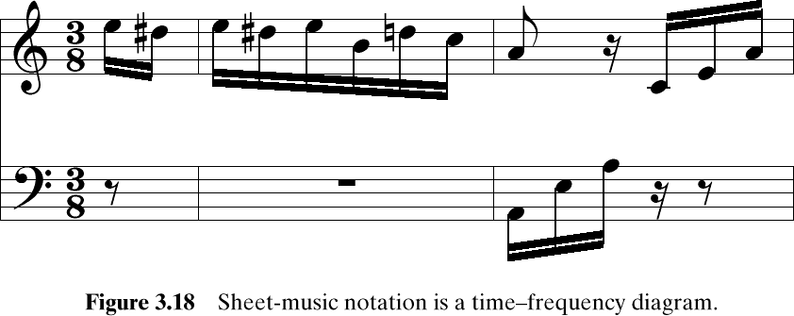
Another FREQ. Diagram
A-440
Frequency is the vertical axis
Time is the horizontal axis

Slide 8
MOTIVATION
Synthesize Complicated Signals
  Musical Notes
    Piano uses 3 strings for many notes
    Chords: play several notes simultaneously
  Human Speech
    Vowels have dominant frequencies
    Application: computer generated speech
  Can all signals be generated this way?
    Sum of sinusoids?

Slide 9
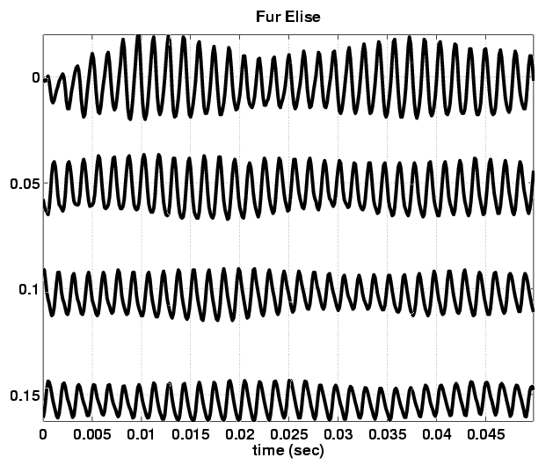
Fur Elise WAVEFORM
Beat
Notes

Slide 10
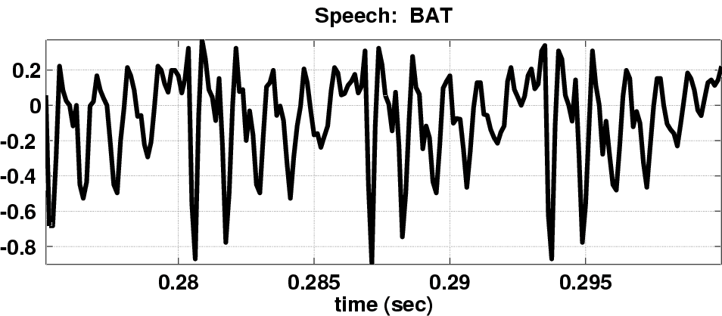
Speech Signal: BAT
Nearly Periodic in Vowel Region
  Period is (Approximately) T = 0.0065 sec

Slide 11
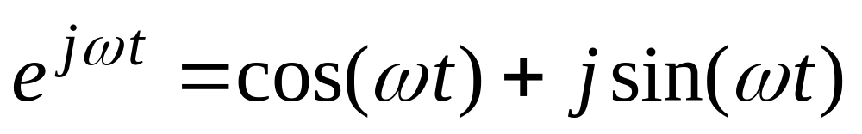
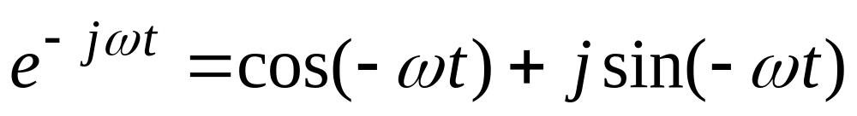
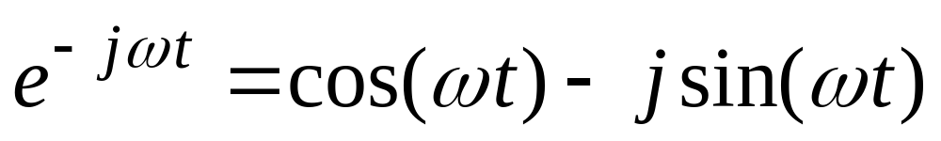
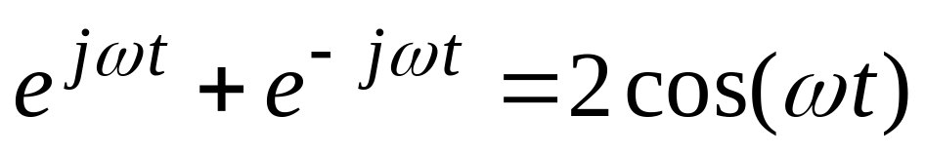
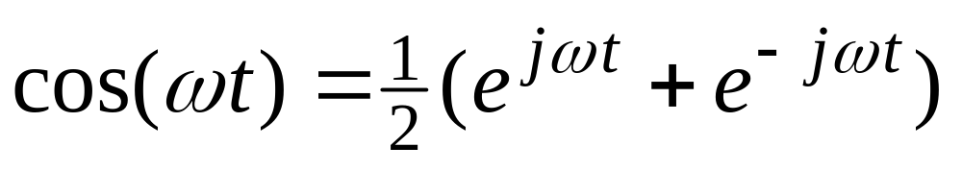
Euler’s Formula Reversed
Solve for cosine (or sine)

Slide 12
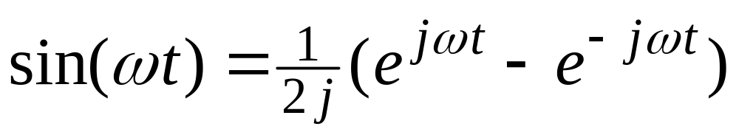
INVERSE Euler’s Formula
Solve for cosine (or sine)

Slide 13
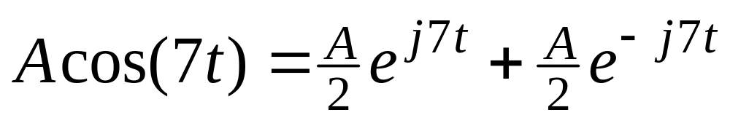
SPECTRUM Interpretation
Cosine = sum of 2 complex exponentials:
  One has a positive frequency
  The other has negative freq.
  Amplitude of each is half as big

Slide 14
NEGATIVE FREQUENCY
Is negative frequency real?
Doppler Radar provides an example
  Police radar measures speed by using the Doppler shift principle
  Let’s assume 400Hz ←→60 mph
  +400Hz means towards the radar
  -400Hz means away (opposite direction)
  Think of a train whistle

Slide 15
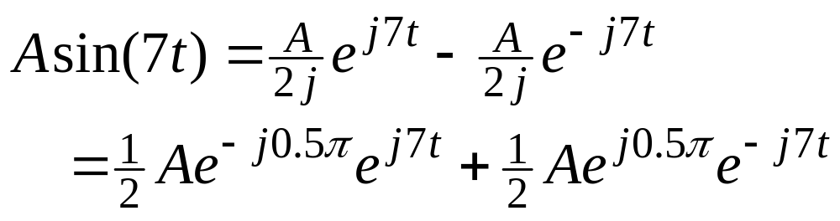
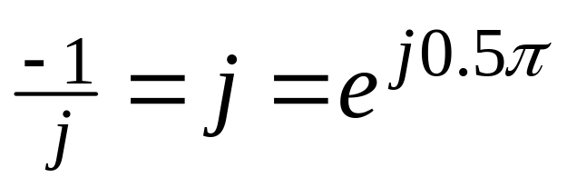
SPECTRUM of SINE
Sine = sum of 2 complex exponentials:
  Positive freq. has phase = -0.5π
  Negative freq. has phase = +0.5π

Slide 16
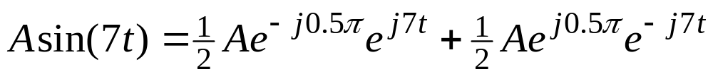
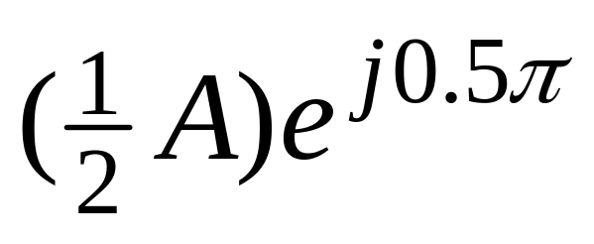
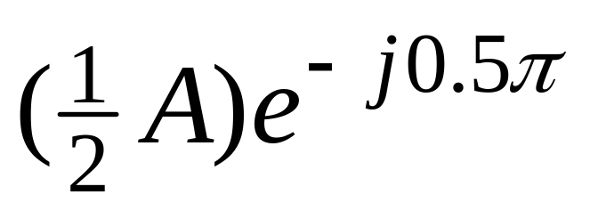
GRAPHICAL SPECTRUM
EXAMPLE of SINE
-7
0
7
ω
AMPLITUDE, PHASE & FREQUENCY are shown

Slide 17
SPECTRUM ---> SINUSOID
Add the spectrum components:
–250
–100
0
100
250
f (in Hz)
What is the formula for the signal x(t)?

Slide 18
Gather (A,ω,φ) information
Frequencies:
  -250 Hz
  -100 Hz
  0 Hz
  100 Hz
  250 Hz
Amplitude & Phase
  4 -π/2
  7 +π/3
  10 0
  7 -π/3
  4 +π/2
Note the conjugate phase
DC is another name for zero-freq component
DC component always has φ=0 or π (for real x(t) )

Slide 19
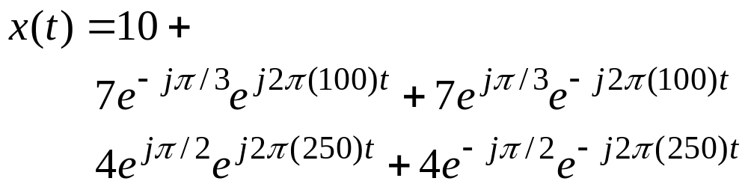
Add Spectrum Components-1
Frequencies:
  -250 Hz
  -100 Hz
  0 Hz
  100 Hz
  250 Hz
Amplitude & Phase
  4 -π/2
  7 +π/3
  10 0
  7 -π/3
  4 +π/2

Slide 20
Add Spectrum Components-2
–250
–100
0
100
250
f (in Hz)

Slide 21
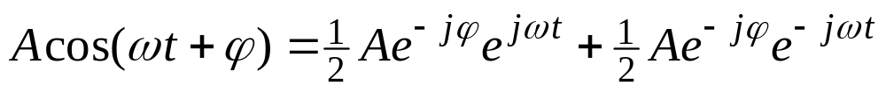
Simplify Components
Use Euler’s Formula to get REAL sinusoids:

Slide 22
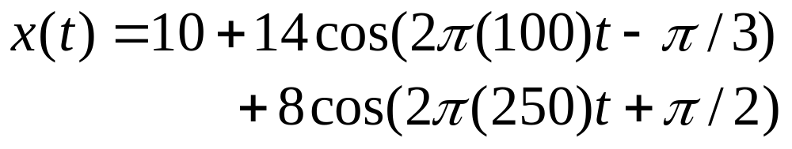
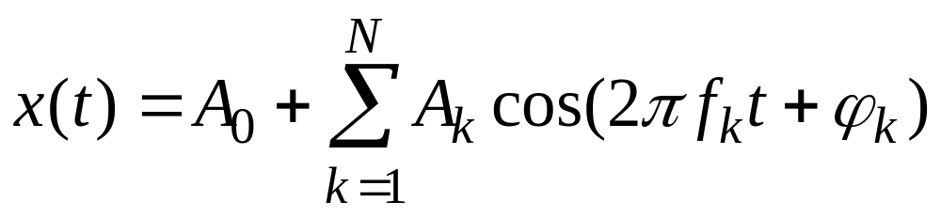
FINAL ANSWER
So, we get the general form:

Slide 23
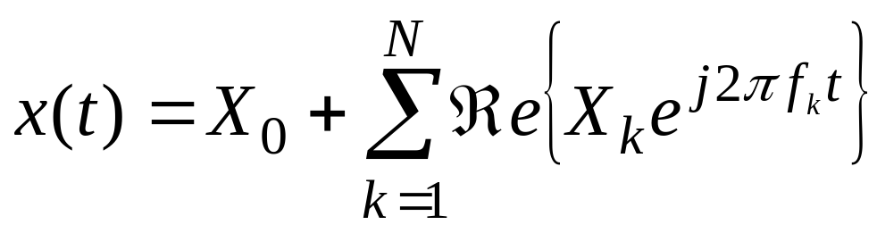
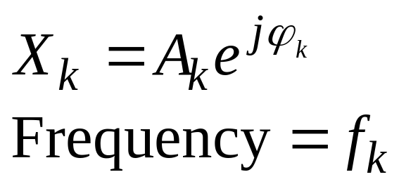
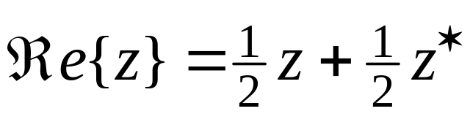
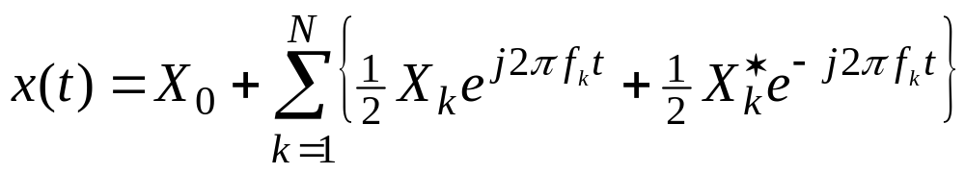
Summary: GENERAL FORM

Slide 24
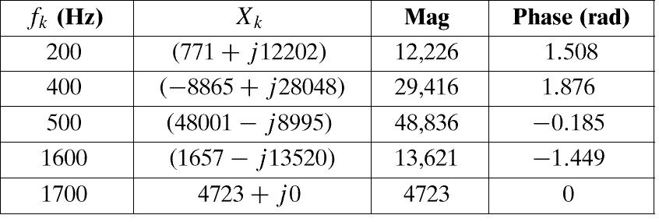
Example: Synthetic Vowel
Sum of 5 Frequency Components
  Complex amplitudes for harmonic signal that approximates the vowel sound «ah»

Slide 25
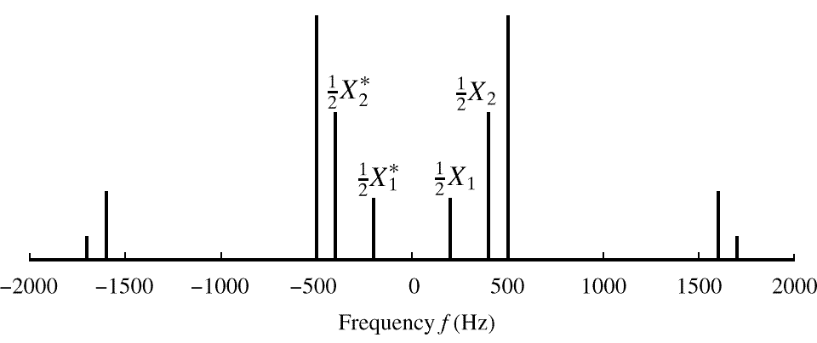
SPECTRUM of VOWEL
  Note: Spectrum has 0.5X_{k} (except X_{DC})
  Conjugates in negative frequency

Slide 26
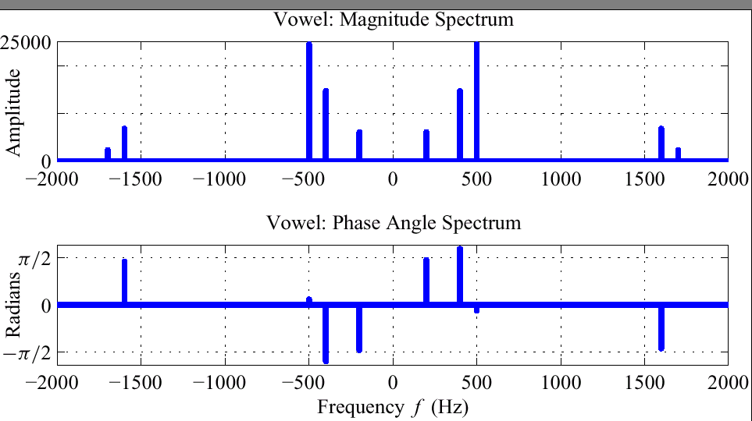
SPECTRUM of VOWEL (Polar Format)
0.5A_{k}
φ_{k}

Slide 27
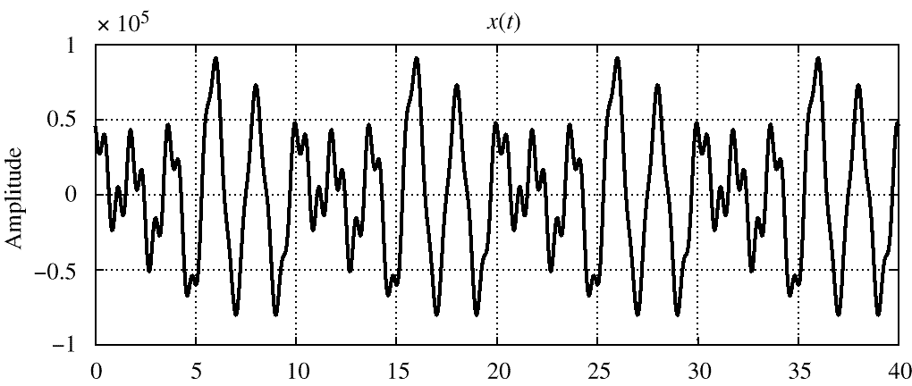
Vowel Waveform (sum of all 5 components)
Sum of all of the signals in the prevous slides
  Note that the period is 10 ms, which equals 1/f₀

Slide 28
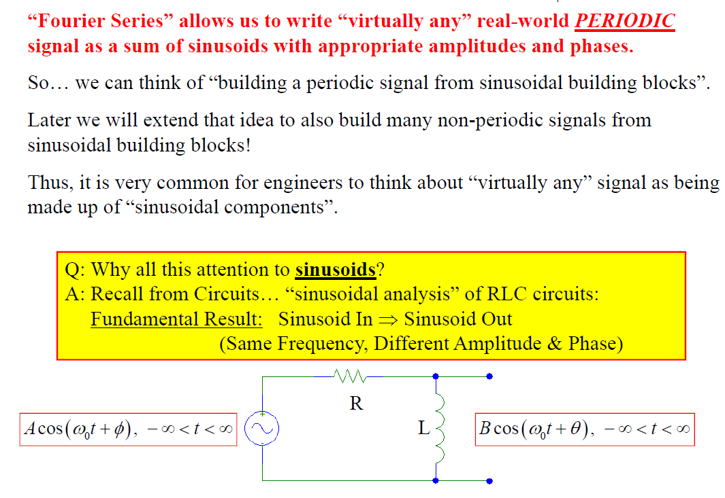
Fourier Series Motivation

Slide 29
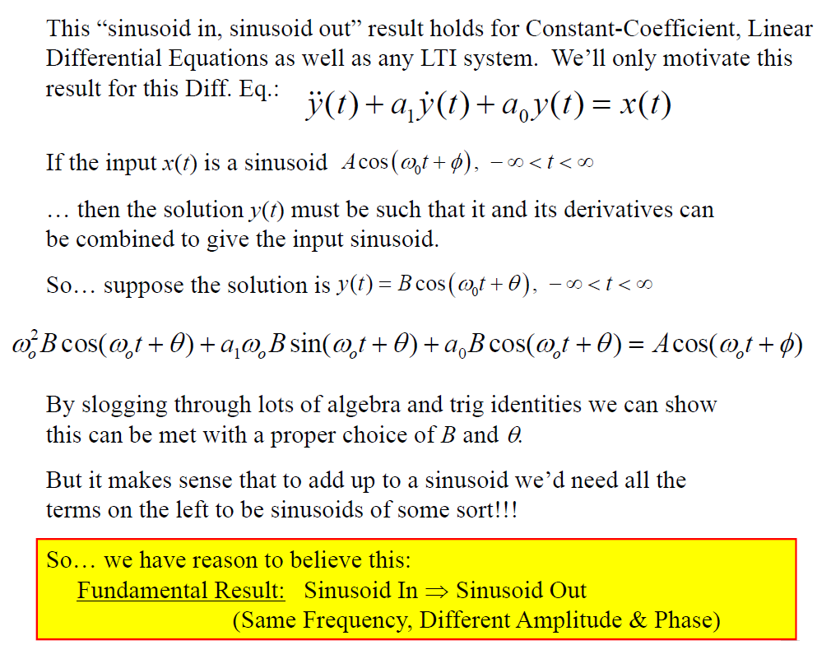
Fourier Series Motivation

Slide 30
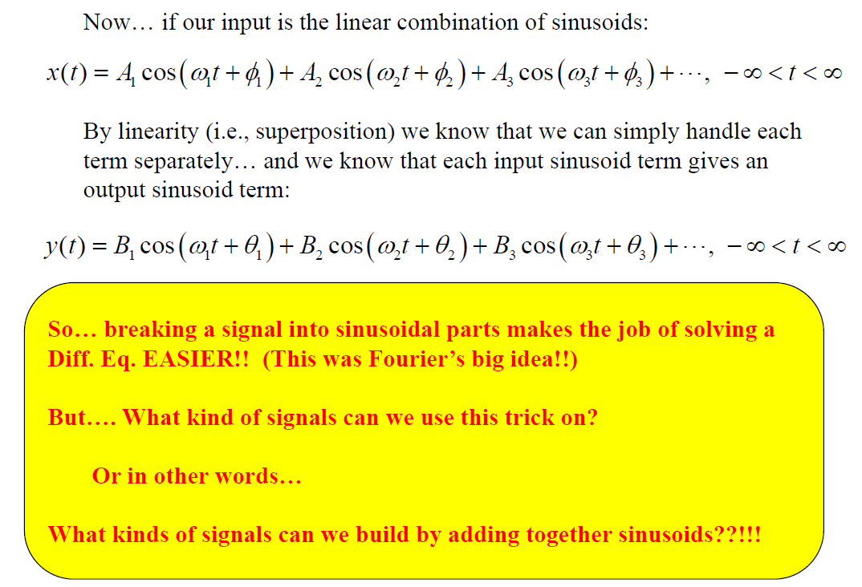
Fourier Series Motivation

Slide 31
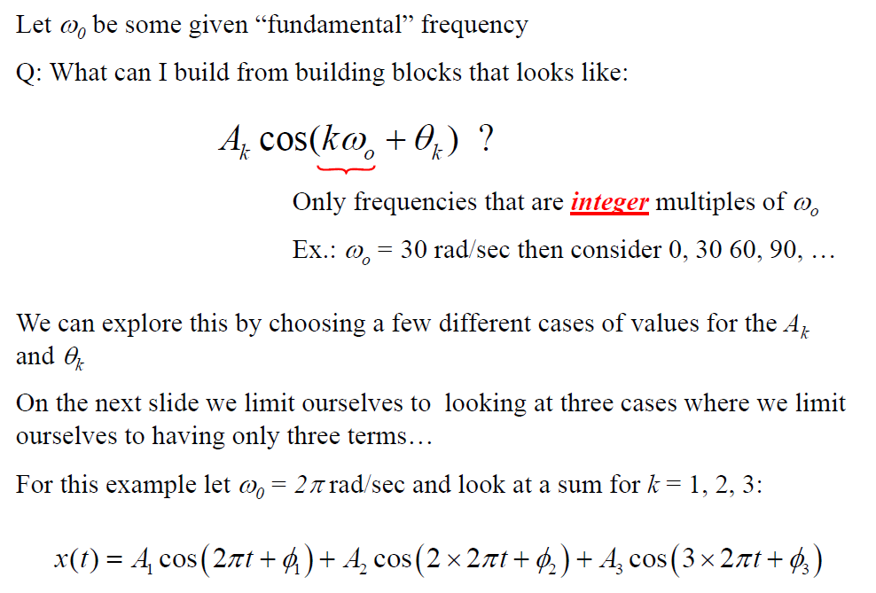
What Can We Build with Sinusoids?

Slide 32
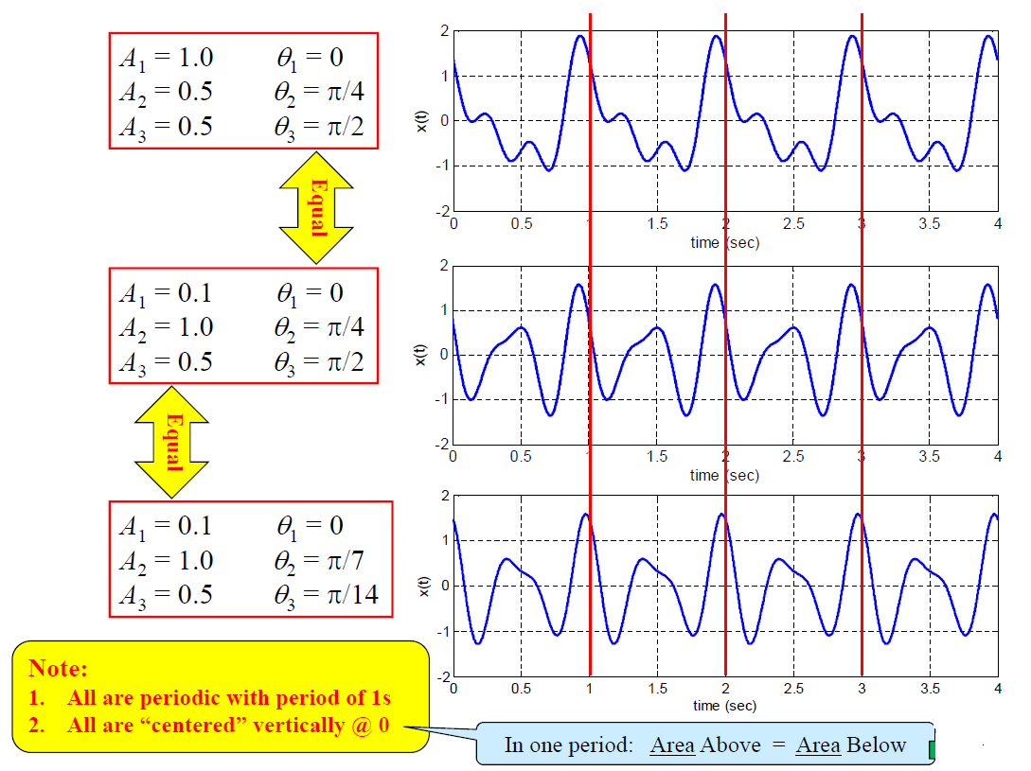
What Can We Build with Sinusoids?

Slide 33
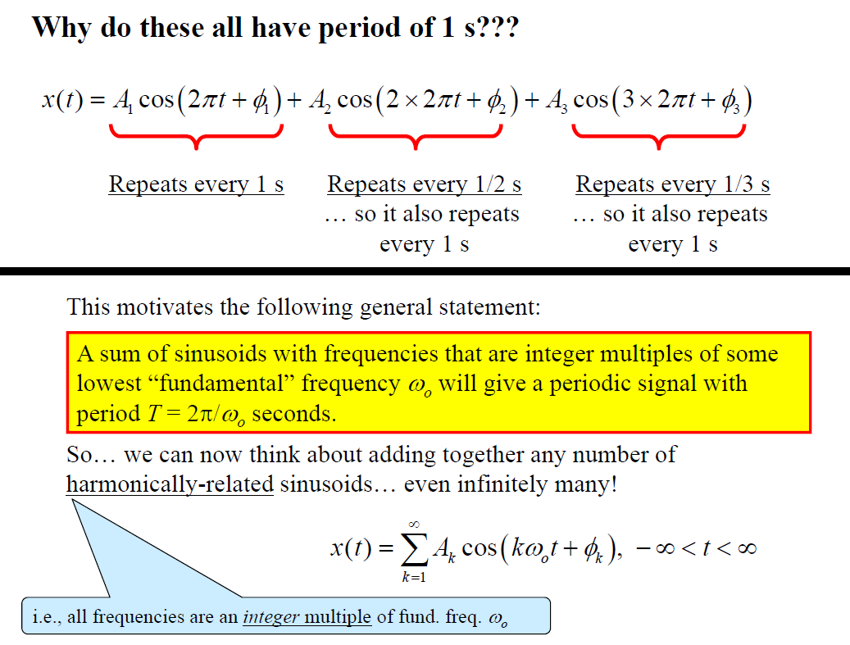
What Can We Build with Sinusoids?

Slide 34
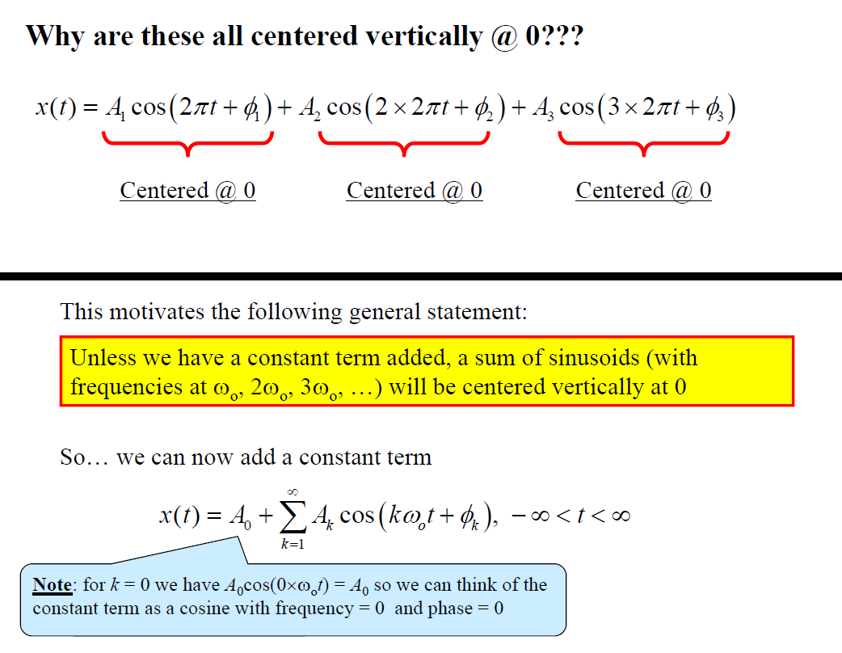
What Can We Build with Sinusoids?

Slide 35
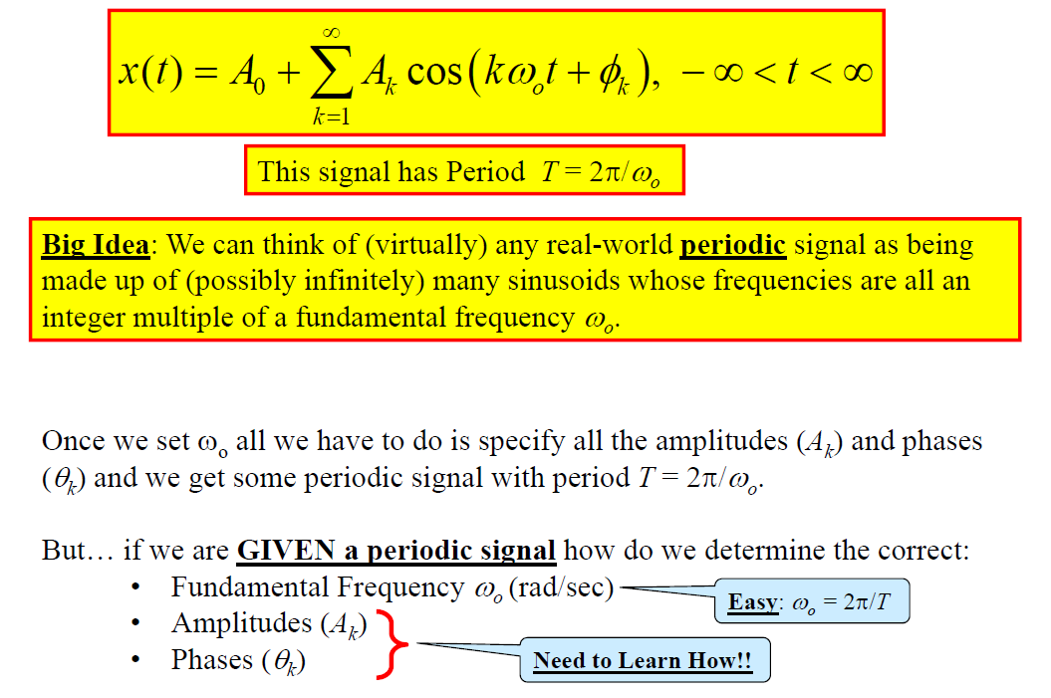
Fourier Series… A Way to Build a Periodic Signal

Slide 36
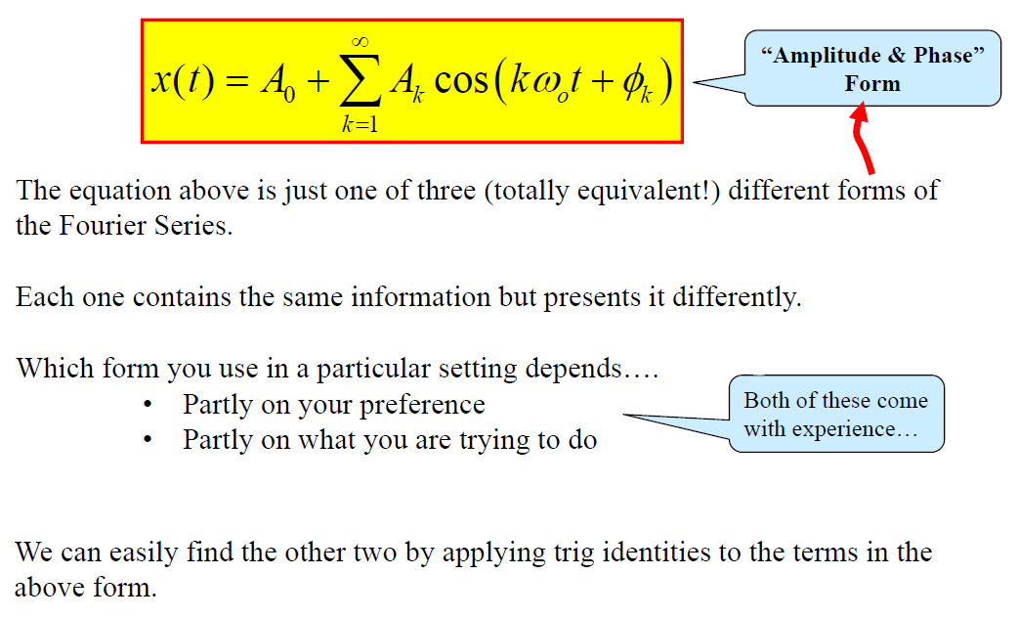
Three Forms of Fourier Series

Slide 37
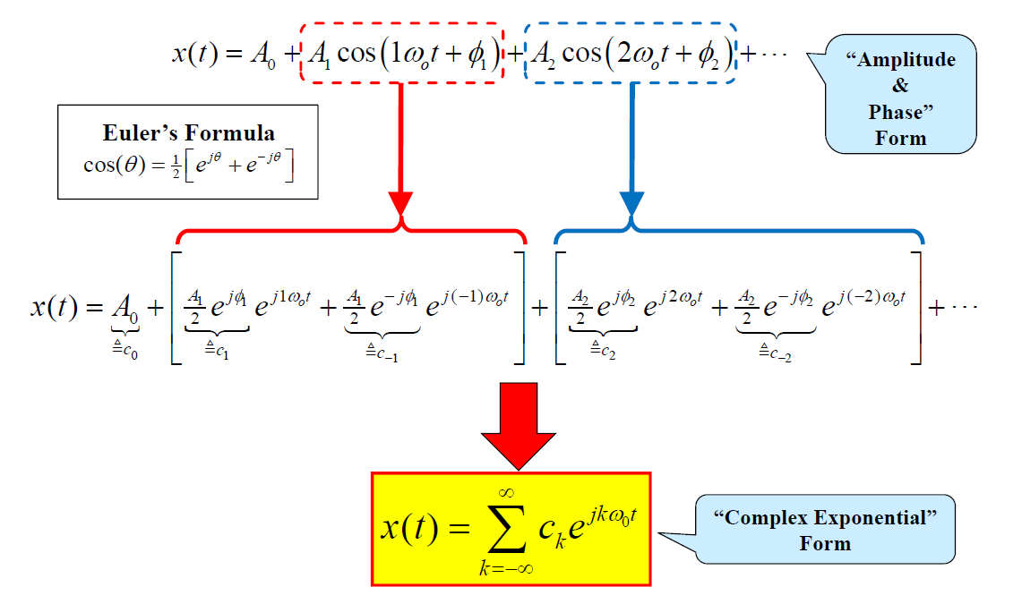
Convert to Complex Exponential Form

Slide 38
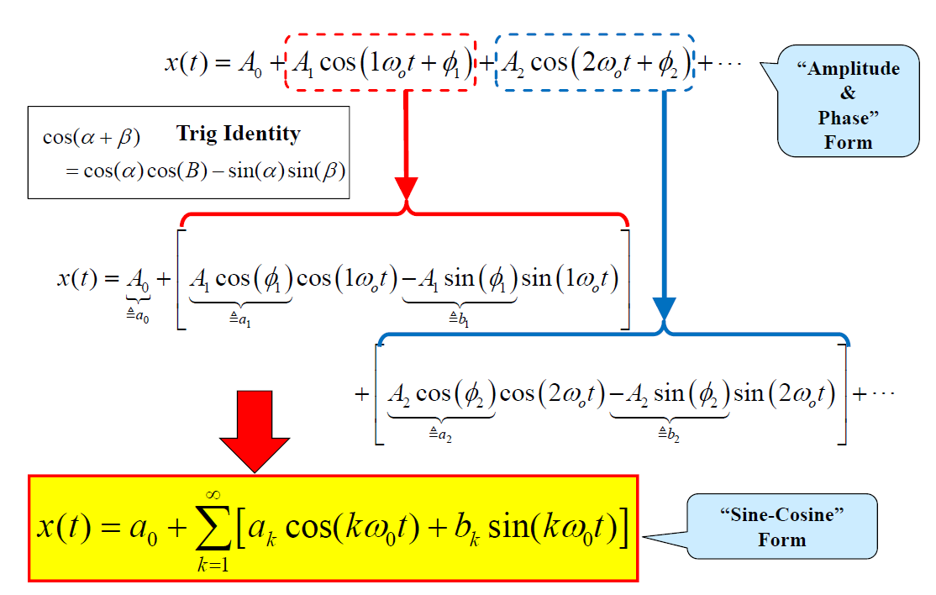
Convert to Sine-Cosine Form

Slide 39
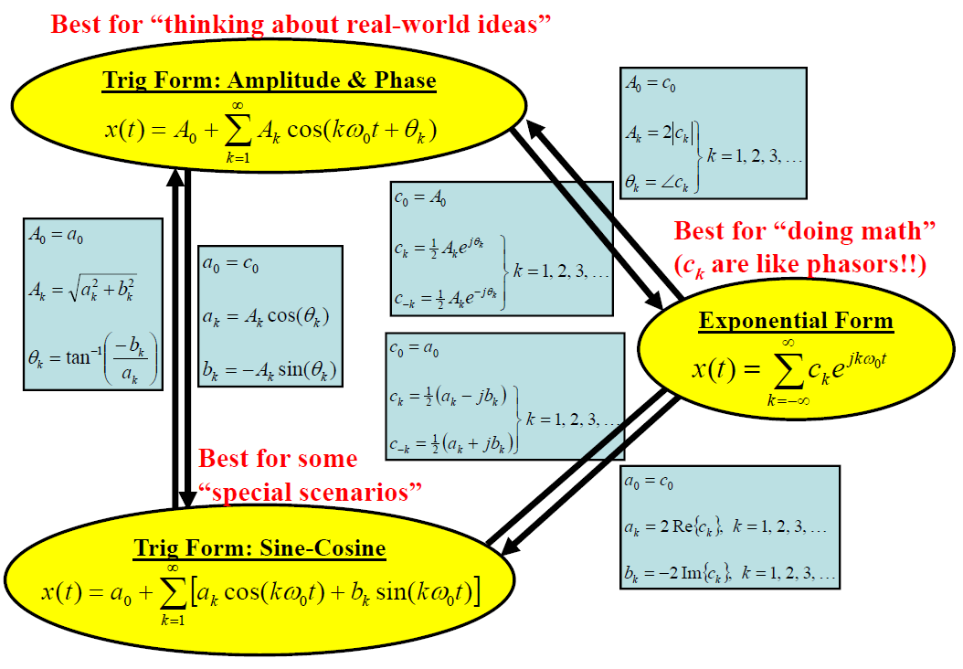
Three (Equivalent) Forms of FS and Their Relationships

Slide 40
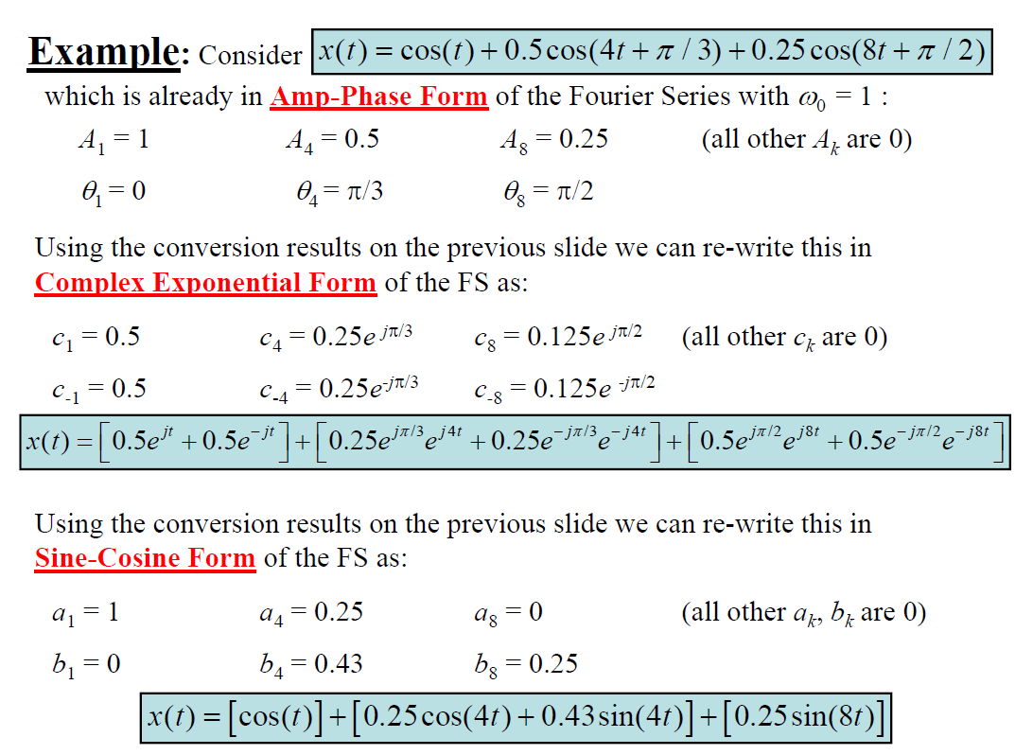
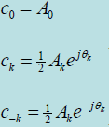


Slide 41

Analytically Finding FS Coefficients

Slide 42

Analytically Finding FS Coefficients

Slide 43

Analytically Finding FS Coefficients

Slide 44

Analytically Finding FS Coefficients

Slide 45

Analytically Finding FS Coefficients

Slide 46

Analytically Finding FS Coefficients

Slide 47


Slide 48


Slide 49


Slide 50

Fourier Series Spectrum

Slide 51

Fourier Series Spectrum

Slide 52

Fourier Series Spectrum

Slide 53

Fourier Series Spectrum

Slide 54

Fourier Series Spectrum

Slide 55

Fourier Series Example

Slide 56

Spectrum

